Slide 1
Building an Image Search Engine Using Feature Matching and Computer Vision
-Achintya Chaitanya (A2305223016)

Slide 2
Index
Introduction
System Design and Architecture
Results and Evaluation
Challenges and Limitations

Slide 3
01
Introduction
Project Aim and Objectives
Theoretical Background

Slide 4
Project Aim and Objectives
The aim of the project is to build an Image Search Engine Using Feature Matching and Computer Vision.
An image search engine that allows users to search for images based on visual content rather than relying on text-based keywords. By utilizing feature extraction techniques and efficient search algorithms like KD-Trees, the system identifies and retrieves visually similar images from a given database. This approach enhances search accuracy in scenarios where text descriptions are unavailable or insufficient.

Slide 5
Theoretical Background
SURF (Speeded-Up Robust Features) is used to detect and describe distinctive key-points in images
KD-Tree Indexing : KD-Tree (K-Dimensional Tree) is a data structure optimized for fast nearest-neighbour searches.
Core Principle
This method leverages the uniqueness of local image features (key-points) and efficiently compares them using KD-Trees, ensuring scalability for large image datasets.

Slide 6
02
System Design and Architecture
Implementation Details
Database and Query Management

Slide 7
Implementation
Image Database Management: Managed with imageDatastore() in MATLAB.
Feature Extraction: detectSURFFeatures() for key point detection. extractFeatures() for generating feature descriptors.
KD-Tree Search: KDTreeSearcher() for efficient feature indexing. knnsearch() for finding nearest neighbours.
Result Display: Ranked results shown with matched key points visualization.

Slide 8
Database and Query Management
Image Database Structure: Stored images with proper indexing for efficient retrieval. Each feature descriptor is linked to its corresponding image ID.
Query Image Processing: Input query image is processed similarly for feature extraction. Features are matched with database entries to identify similar images.

Slide 9
02
System Design and Architecture
Implementation Details
Database and Query Management

Slide 10
Implementation
Image Database Management: Managed with imageDatastore() in MATLAB.
Feature Extraction: detectSURFFeatures() for key point detection. extractFeatures() for generating feature descriptors.
KD-Tree Search: KDTreeSearcher() for efficient feature indexing. knnsearch() for finding nearest neighbours.
Result Display: Ranked results shown with matched key points visualization.

Slide 11
Database and Query Management
Image Database Structure: Stored images with proper indexing for efficient retrieval. Each feature descriptor is linked to its corresponding image ID.
Query Image Processing: Input query image is processed similarly for feature extraction. Features are matched with database entries to identify similar images.

Slide 12
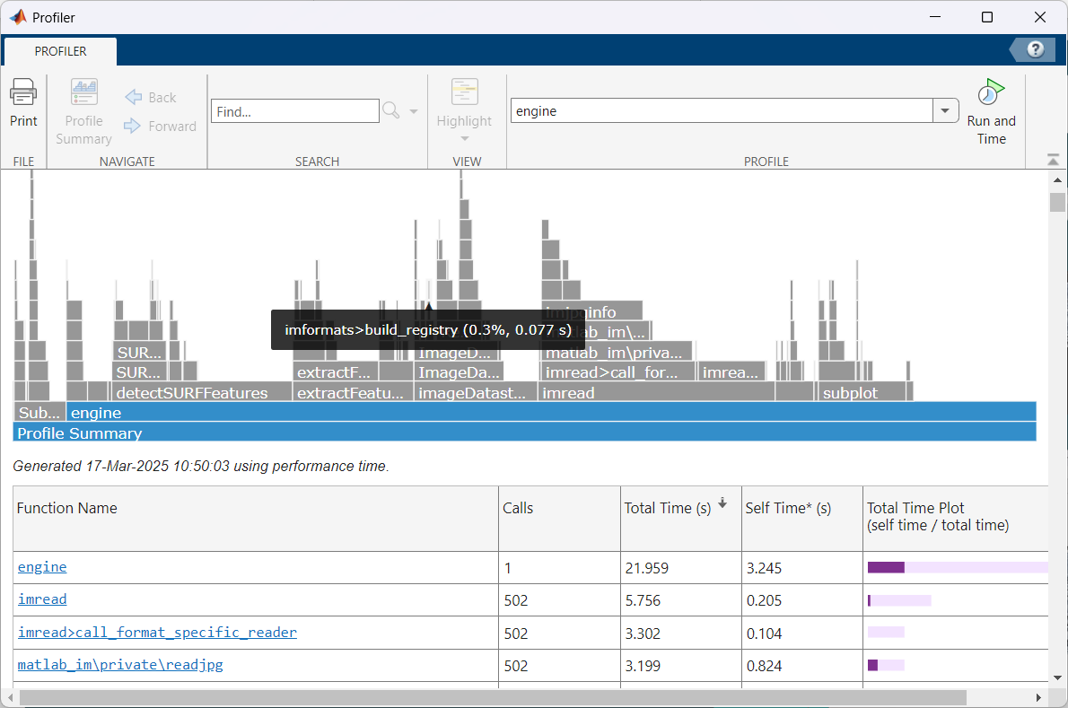
Results and Evaluation
03
The program executes in 21.959 sec with a dataset size 500 images

Slide 13
Challenges and Limitations
04
The program executes in 21.959 sec with a dataset size 500 images and the process time increases with data set increasing which can extend to hours when scaled to a sample size of 1000
The program lacks a GUI interface to input images and the image to be searched has to be added in execution directory as “query.jpg” to be executed

Slide 14
Resources
MATLAB Toolboxes
https://in.mathworks.com/products/statistics.html
https://in.mathworks.com/products/computer-vision.html
Theory Resources
https://www.geeksforgeeks.org/ball-tree-and-kd-tree-algorithms/
https://en.wikipedia.org/wiki/K-d_tree

